Slide 1
Machine Learning
机器学习
Lecture 1: The Learning Problem
南晓斐
Xiaofei Nan

Slide 2
The Learning Problem
What is Machine Learning
From Learning to Machine Learning
Learning: acquiring Skill
with experience accumulated from observations
observations
Learning
skill
Machine Learning(ML): acquiring Skill with experience
accumulated/computed from data
data
ML
skill
What is skill?

Slide 3
The Learning Problem
What is Machine Learning
A More Concrete Definition
Skill:
Improve some performance measure (e.g. prediction accuracy)
Machine Learning: improving some performance measure
with experience computed from data
improved performance measure
data
ML
An Application in Computational Finance
stock data
ML
more investment gain
Why use Machine Learning?

Slide 4
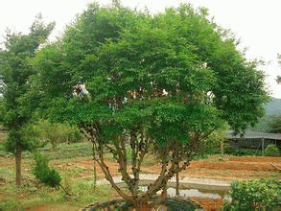

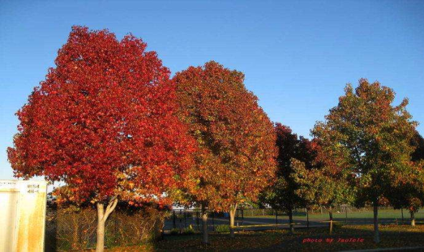
The Learning Problem
What is Machine Learning
An Application: Tree Recognition
define trees and hand-program: difficult
Learn from data (observations) and recognize:
a little boy/girl can do so
ML-based tree recognition system can be easier to build than hand-programmed system
ML: an alternative route to build complicated systems

Slide 5
The Learning Problem
What is Machine Learning
The Machine Learning Route
ML: an alternative route to build complicated systems
Some Use Scenarios
When human cannot program the system manually --- navigating on Mars
When human cannot define the solution easily --- speech/visual recognition
When needing rapid decisions that humans cannot do
--- high-frequency trading
When needing to be user-oriented in a massive scale
--- consumer-targeted marketing

Slide 6
The Learning Problem
What is Machine Learning
Key Essence of Machine Learning
Machine Learning: improving some performance measure
with experience computed from data
improved performance measure
data
ML
exists some underlying pattern to be learned
--- so performance measure can be improved
but no programmable (easy) definition
--- so ML is needed
Somehow there is data about the pattern
--- so ML has some inputs to learn from
key essence: help decide whether to use ML or not

Slide 7
The Learning Problem
What is Machine Learning
Quick Quiz
Which of the following is best suited for machine learning?
predicting whether the next cry of a baby happens at an even-numbered minute or not
determining whether a given graph contains a cycle
deciding whether to approve credit card to some customer
guessing whether the earth will be destroyed by the misuse of nuclear power in the next ten years
Reference Answer: ③
no pattern
programmable definition
pattern : customer behavior; definition: not easily programmable; data: history of bank operation
arguably no (or not enough) data yet

Slide 8
The Learning Problem
Applications of Machine Learning
Daily Needs
data
ML
skill
Spam Filter
data: emails
skill: tell whether an email is spam or not
Facial recognition system
data: facial data
skill: tell whether a person is allowed to enter or not
Recommendation system
data: client data (purchases, ratings), product data (key features)
skill: give personal recommendations to clients
Vehicle license plate recognition
data: license plate pictures
skill: license plate characters and numbers

Slide 9
The Learning Problem
Applications of Machine learning
Online Education
data
ML
skill
data: students’ records on quizzes on a tutoring system
skill: predict whether a student can give a correct answer to another quiz question
A Possible ML Solution
answer correctly ≈ recent level of student > difficulty of question
give ML 9 million records from 3000 students
ML determines (reverse-engineers) level and difficulty automatically
KDD Cup 2010

Slide 10
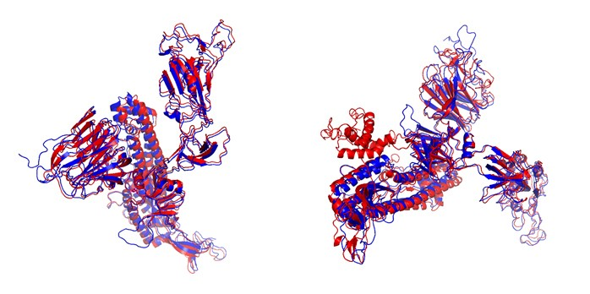
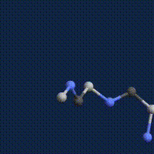
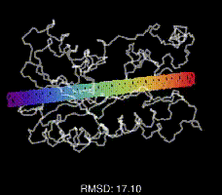
The Learning Problem
Applications of Machine Learning
COVID19 3D Structure Recognition
data
ML
skill
data: existing protein sequences and structures
skill: predict COVID19 protein structure based on its gene sequence

Slide 11
The Learning Problem
Applications of Machine Learning
Quick Quiz
Which of the following field cannot use machine learning?
Finance
Medicine
Law
none of the above
Reference Answer: ④
predict stock price from data
predict medicine effect from data
summarize legal documents from data
Machine learning is almost everywhere

Slide 12
The Learning Problem
Summary
Summary
What is Machine Learning
Key Essence of Machine Learning
Applications of Machine Learning
Could you list some machine learning application examples?

Slide 13
Machine Learning
机器学习
Lecture 2: Types of Learning

Slide 14
Types of Learning
Roadmap
Lecture 2: Types of Learning
•Learning with Different Output Space Y
•Learning with Different Data Label Y
•Learning with Different Protocol f (Xn,Yn)
•Learning with Different Input Space X

Slide 15
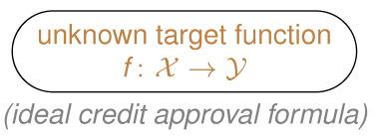
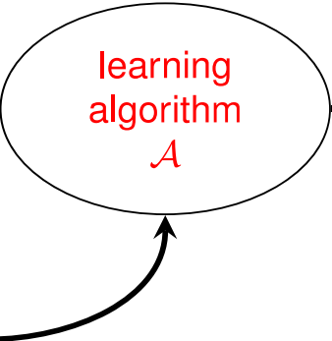
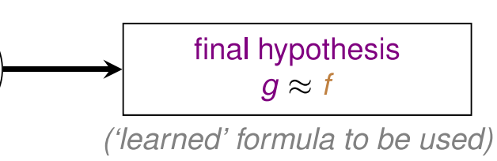
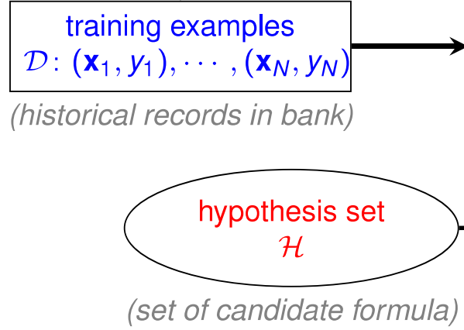
Types of Learning
Learning with Different Output Space Y
Credit Approval Problem Revisited
age | 28
gender | female
Annual salary | 200000
year in residence | 2 years
year in job | 1 year
Current debt | 600000
Credit ={yes, no}

Slide 16
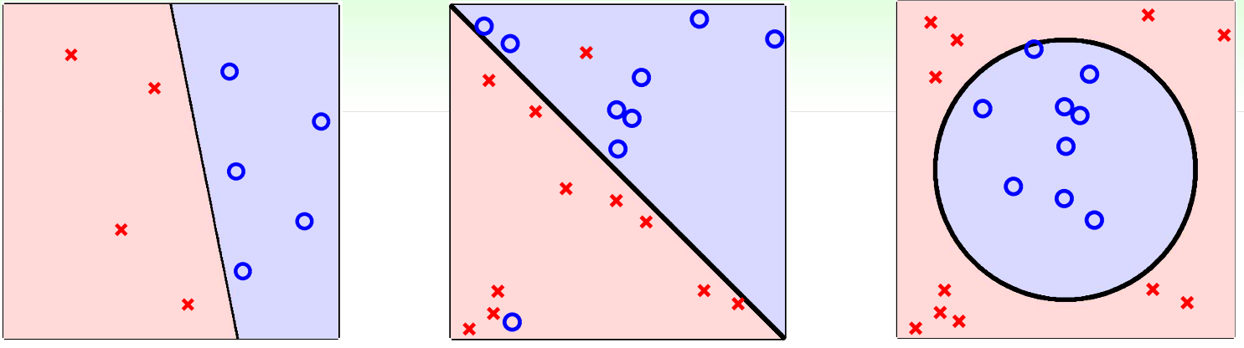
Types of Learning
Learning with Different Output Space Y
More Binary Classification Problems
•credit approve/disapprove
•email spam/non-spam
•patient sick/not sick
•ad profitable/not profitable
•answer correct/incorrect
core and important problem with many tools as building block of other tools

Slide 17
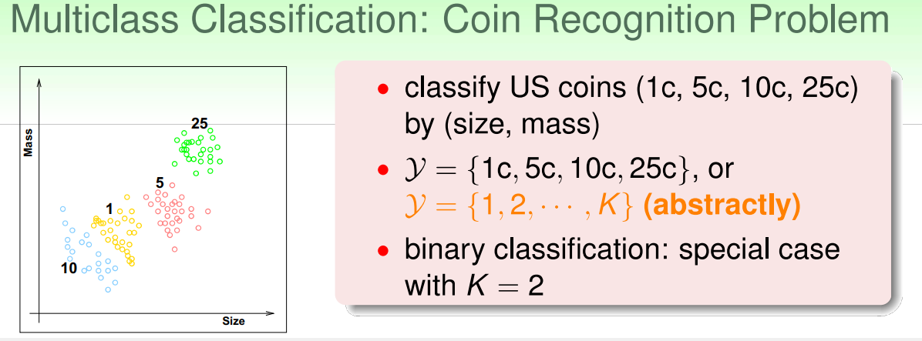
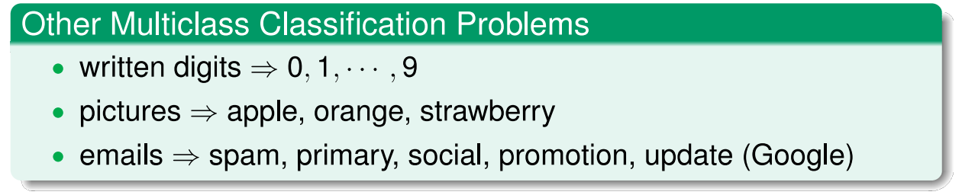
Types of Learning
Learning with Different Output Space Y
Many applications in practice , especially for “recognition”

Slide 18
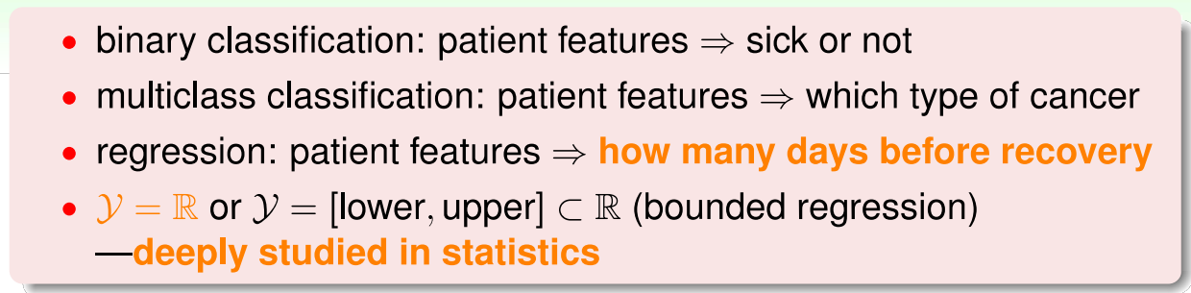
Types of Learning
Learning with Different Output Space Y
Regression: Patient Recovery Prediction Problem
Which of the following is best suited for machine learning?
Other Regression Problems
• company data => stock price
• climate data => temperature
also core and important with many 'statistical' tools as building block of other tools

Slide 19
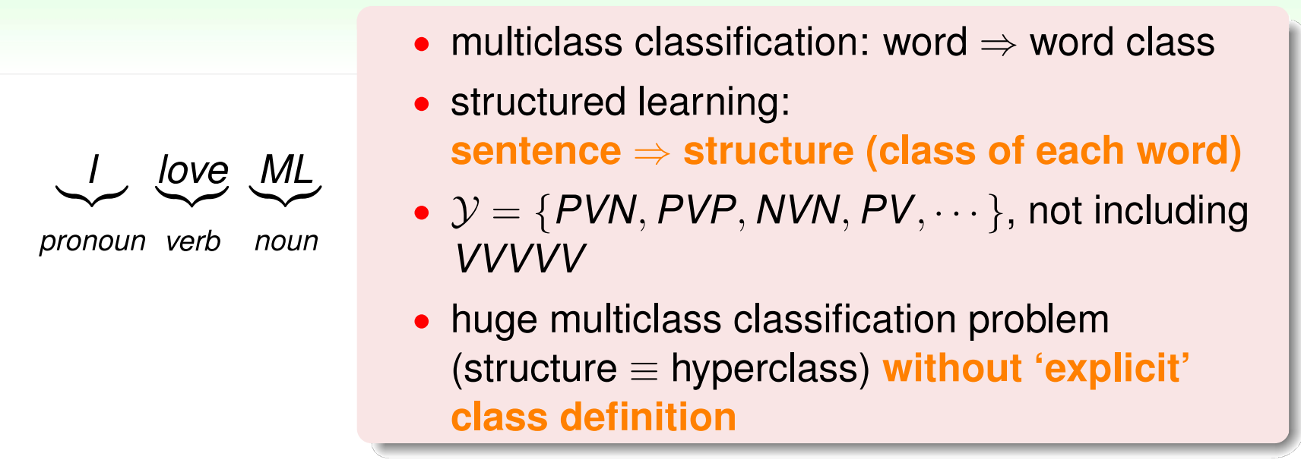
Types of Learning
Learning with Different Output Space Y
Structured Learning: Sequence Tagging Problem
Facial recognition system
data: facial data
skill: tell whether a person is allowed to enter or not
Other Structured Learning Problems
• protein data ===> protein folding
• speech data ===> speech parse tree
a fancy but complicated learning problem

Slide 20
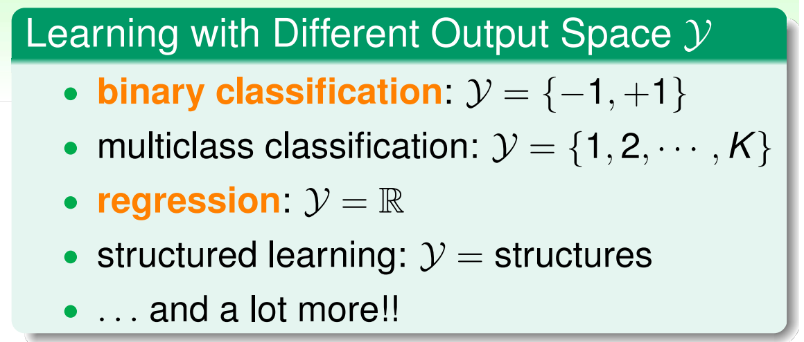
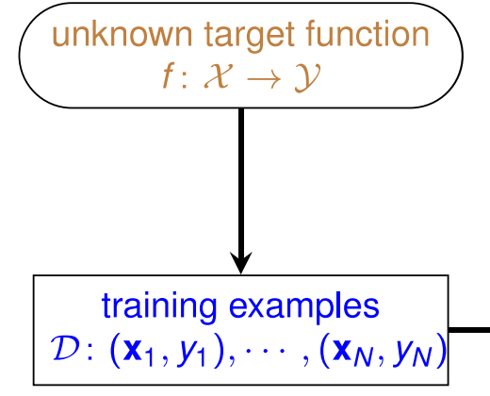
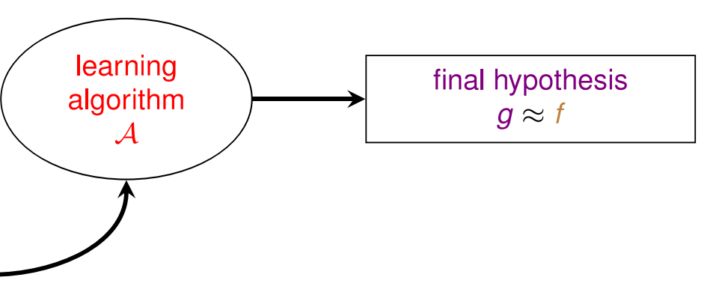
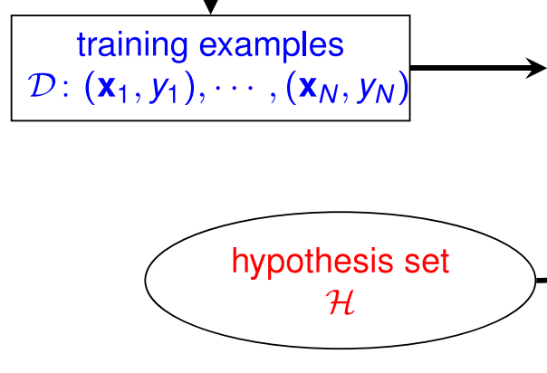
Types of Learning
Learning with Different Output Space Y
Mini Summary
core tools: binary classification and regression

Slide 21
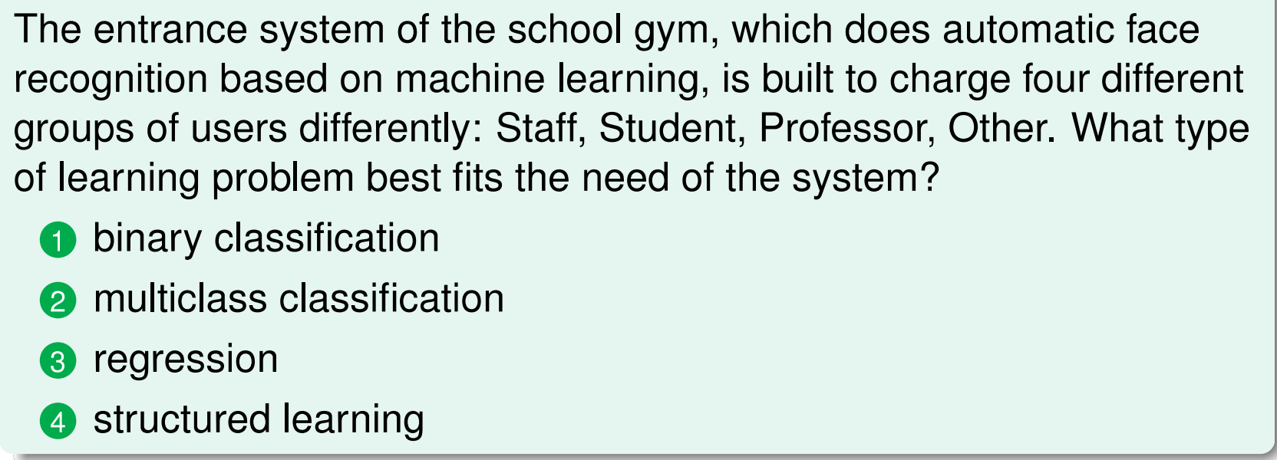
Types of Learning
Learning with Different Output Space Y
Fun Time
What is this learning problem?

Slide 22
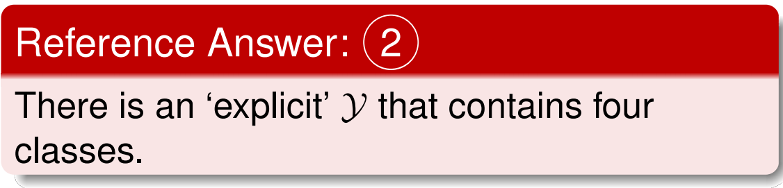
Types of Learning
Learning with Different Output Space Y
Fun Time
What is this learning problem?

Slide 23
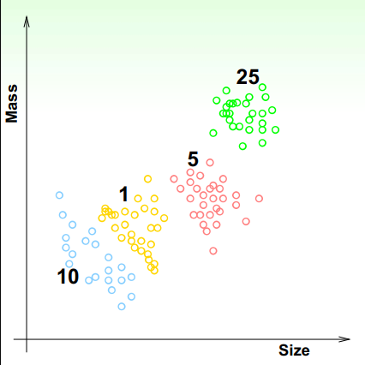
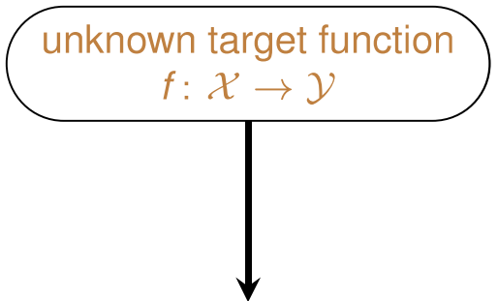
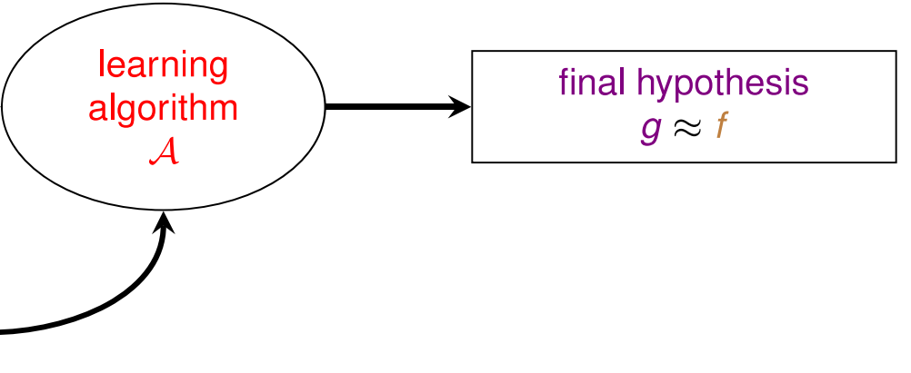
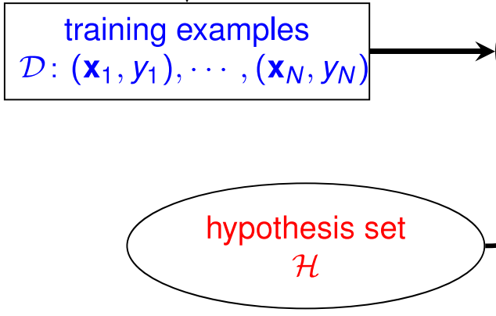
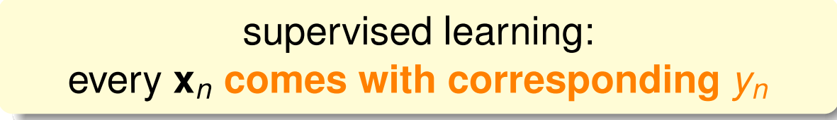
Types of Learning
Learning with Different Data Label Y
Supervised: Coin Recognition Revisited

Slide 24
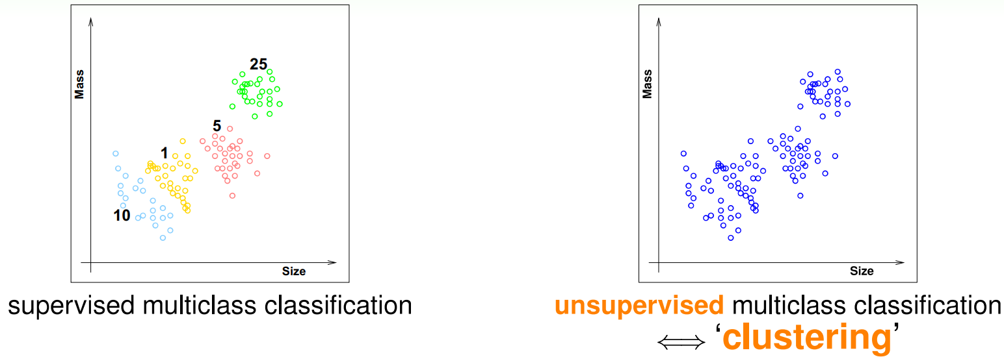
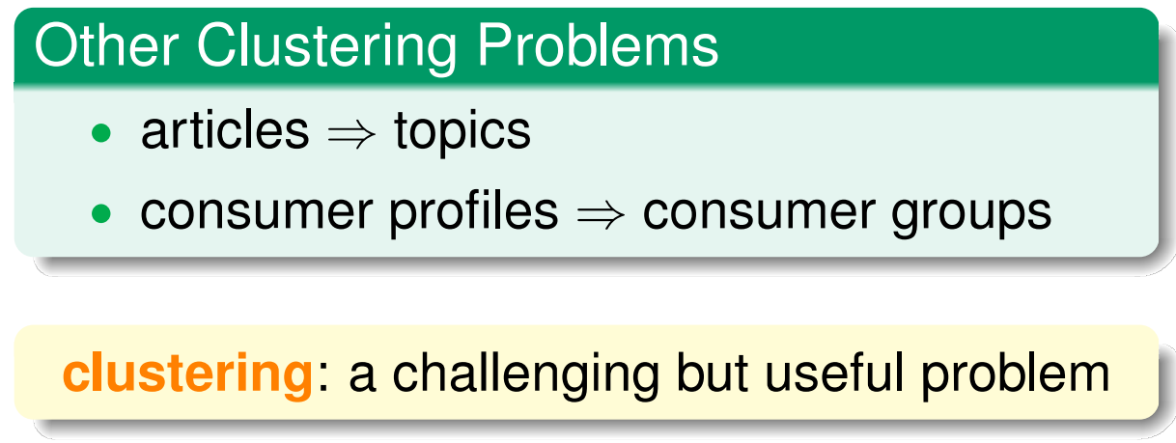
Types of Learning
Learning with Different Data Label Y
Unsupervised: Learning without Y

Slide 25
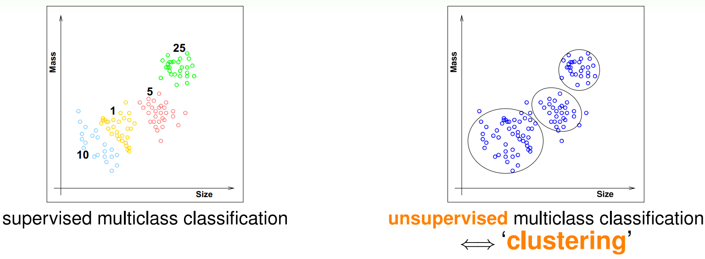
Types of Learning
Learning with Different Data Label Yn
Unsupervised: Learning without Y

Slide 26
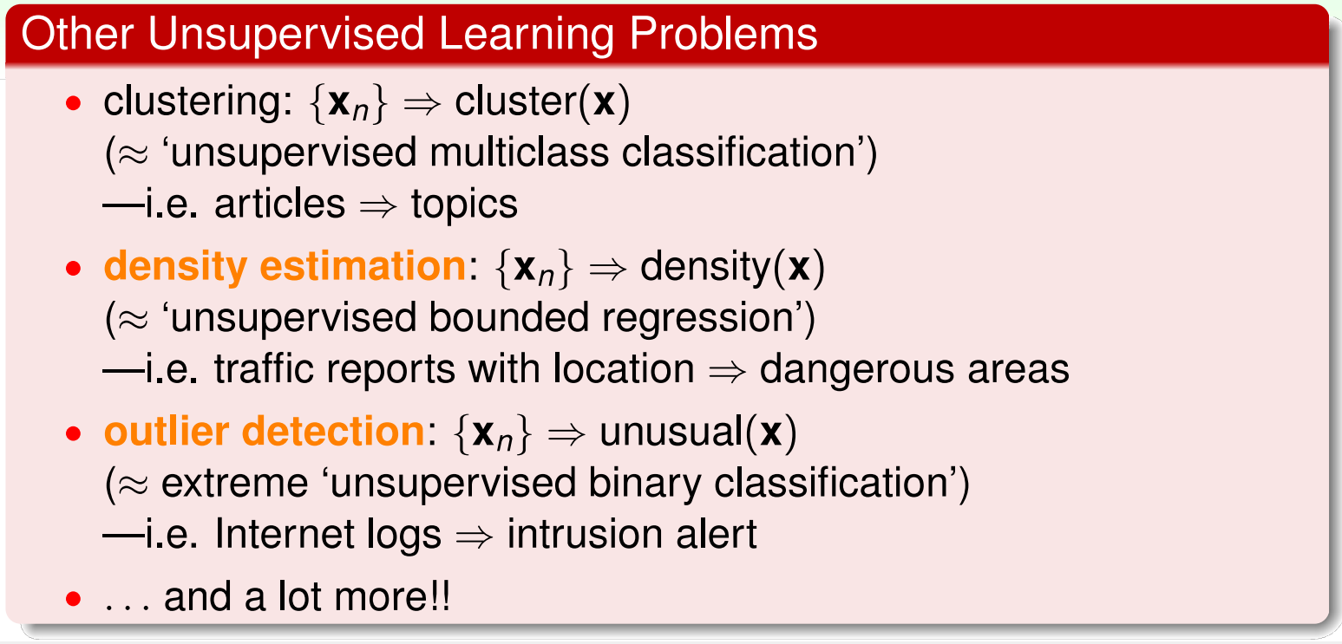
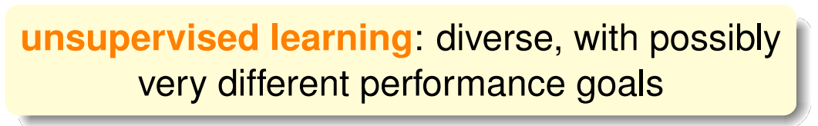
Types of Learning
Learning with Different Data Label Y
Unsupervised: Learning without Y

Slide 27
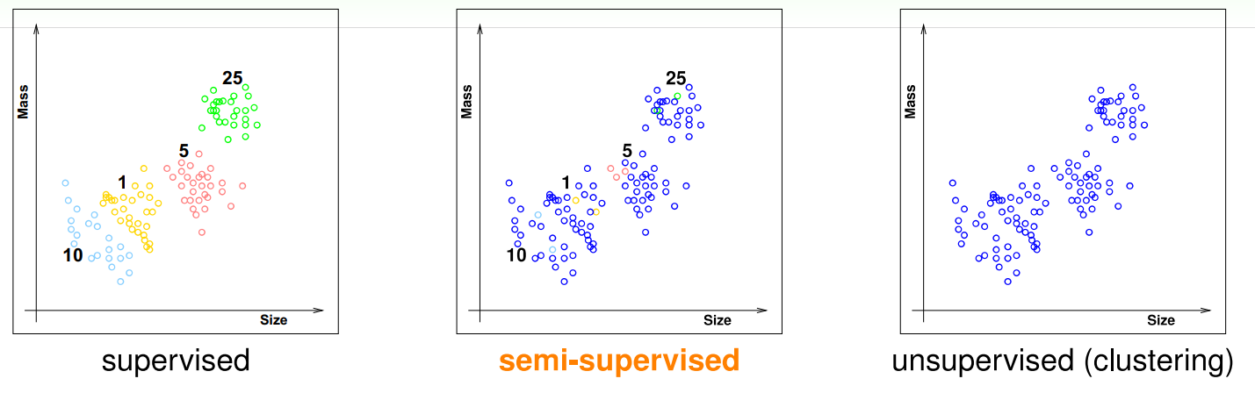
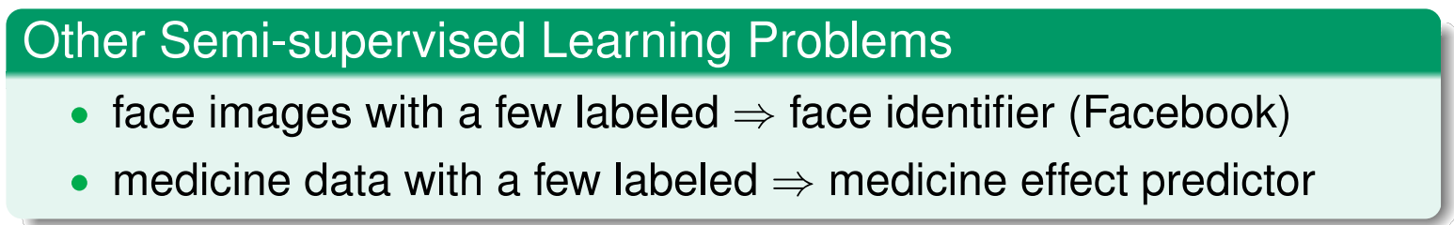
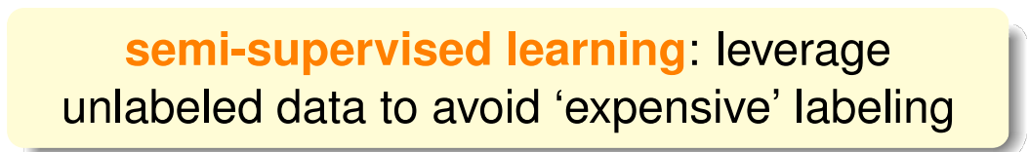
Types of Learning
Learning with Different Data Label Y
Semi-supervised: Coin Recognition with Some Y

Slide 28
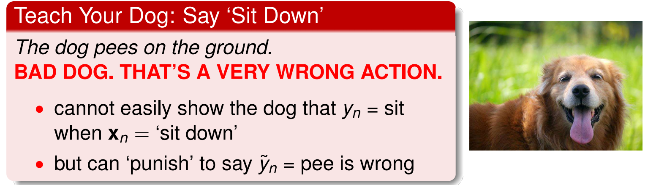
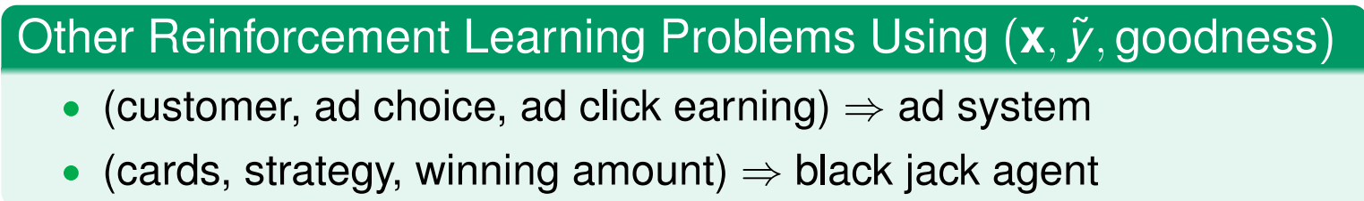
Types of Learning
Learning with Different Data Label Y
Reinforcement Learning
A ‘very different’ but natural way of learning
reinforcement: learn with 'partial/implicit information’ (often sequentially)

Slide 29
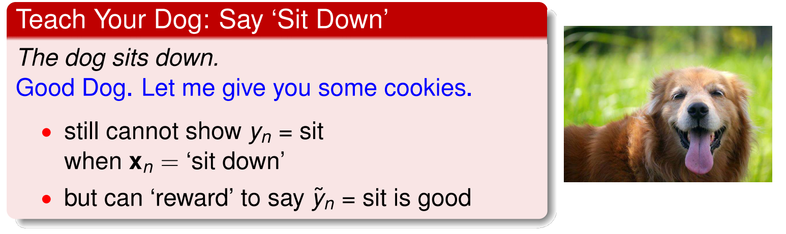
Types of Learning
Learning with Different Data Label Y
Reinforcement Learning
A ‘very different’ but natural way of learning
reinforcement: learn with 'partial/implicit information’ (often sequentially)

Slide 30
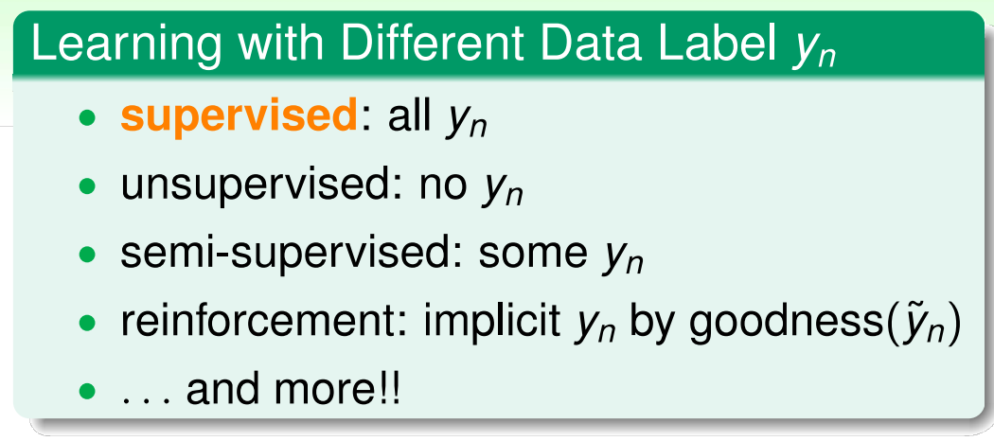
Types of Learning
Learning with Different Data Label Y
Mini Summary
core tools: supervised learning

Slide 31
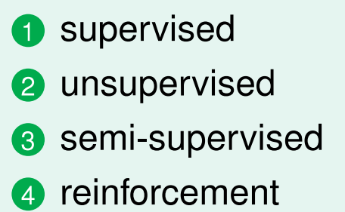
Types of Learning
Learning with Different Data Label Y
Fun Time
What is this learning problem?
To build a tree recognition system, a company decides to gather one million of pictures on the Internet. Then, it asks each of the 10 company members to view 100 pictures and record whether each picture contains a tree. The pictures and records are then fed to a learning algorithm to build the system. What type of learning problem does the algorithm need to solve?

Slide 32
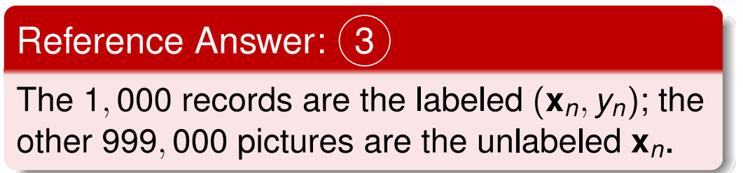
Types of Learning
Learning with Different Data Label Yn
Fun Time
What is this learning problem?
To build a tree recognition system, a company decides to gather one million of pictures on the Internet. Then, it asks each of the 10 company members to view 100 pictures and record whether each picture contains a tree. The pictures and records are then fed to a learning algorithm to build the system. What type of learning problem does the algorithm need to solve?

Slide 33
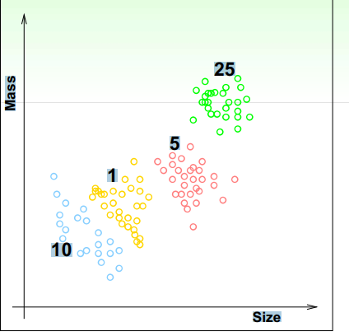
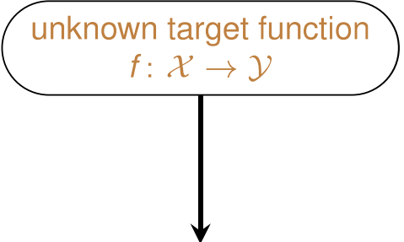
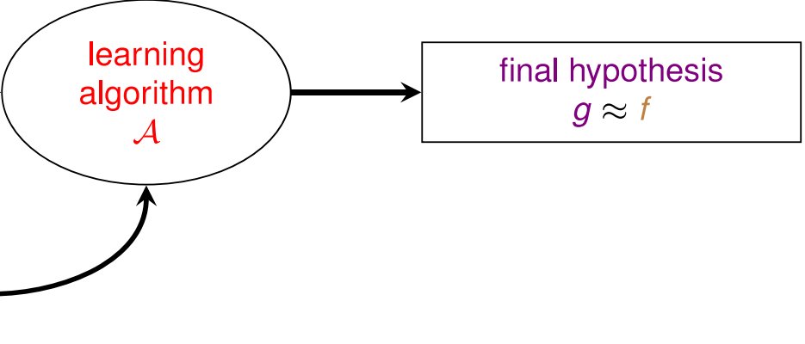
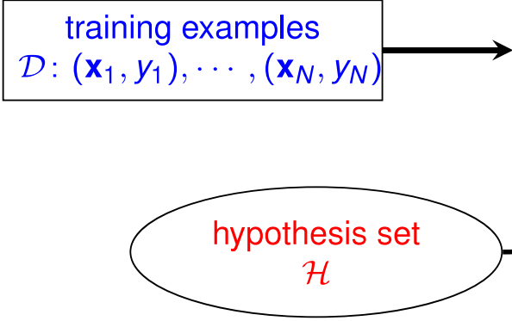
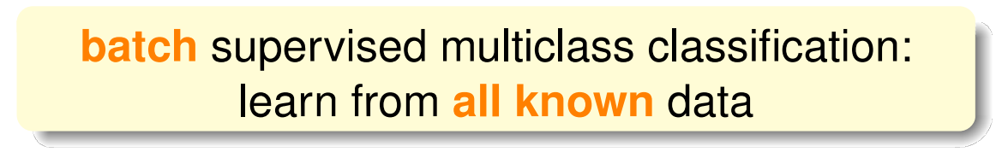
Types of Learning
Learning with Different Protocol f ➔ (Xn,Yn)
Batch Learning: Coin Recognition Revisited

Slide 34
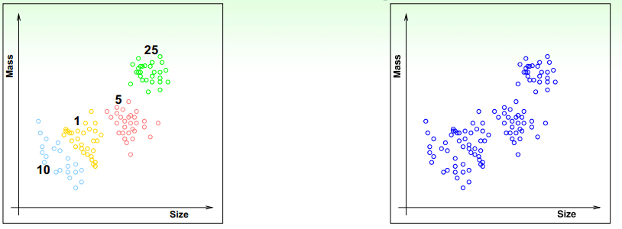
Types of Learning
Learning with Different Protocol f ➔ (Xn,Yn)
More Batch Learning Problems
•batch of (email, spam?) ➔spam filter
•batch of (patient, cancer?) ➔cancer classifier
•batch of patient data ➔group of patients
Batch learning : a very common protocol

Slide 35
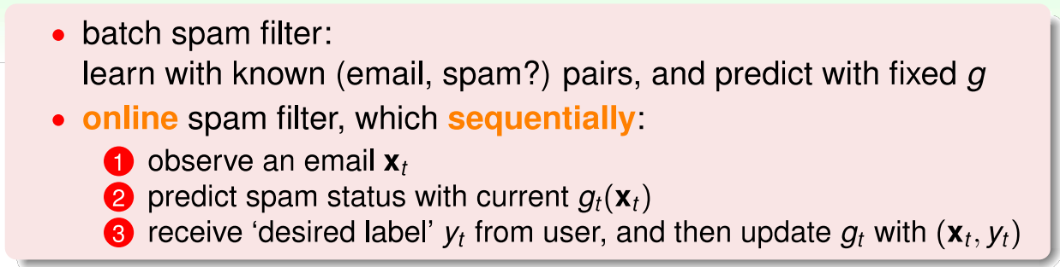
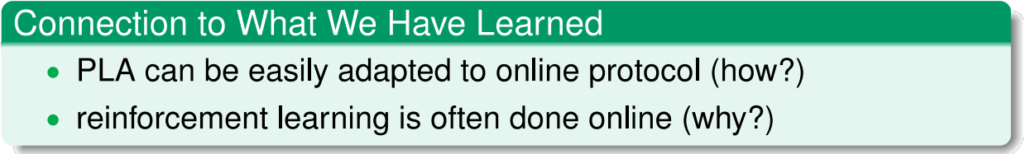
Types of Learning
Learning with Different Protocol f ➔ (Xn,Yn)
Online: Spam Filter that 'Improves'
online: hypothesis 'improves’ through receiving data instances sequentially

Slide 36
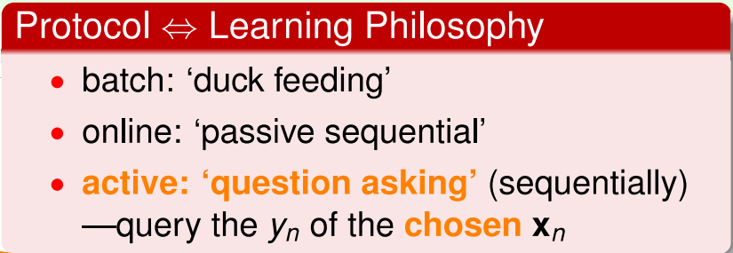
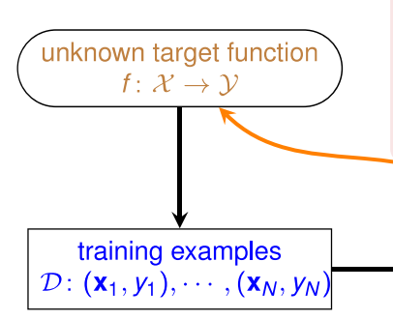
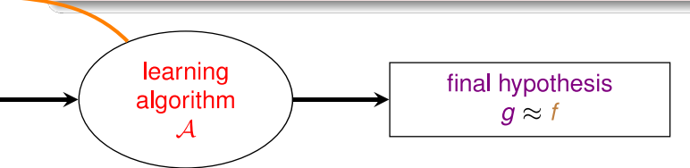


Types of Learning
Learning with Different Protocol f ➔ (Xn,Yn)
Active Learning: Learning by 'Asking'

Slide 37

Types of Learning
Learning with Different Protocol f ➔ (Xn,Yn)
Mini Summary
core protocol: batch

Slide 38

Types of Learning
Learning with Different Protocol f ➔ (Xn,Yn)
Fun Time
What is this learning problem?

Slide 39

Types of Learning
Learning with Different Protocol f ➔ (Xn,Yn)
Fun Time
What is this learning problem?

Slide 40


Types of Learning
Learning with Different Input Space X
Credit Approval Problem Revisited

Slide 41


Types of Learning
Learning with Different Input Space X
More on Concrete Features
Concrete feature : the ‘easy’ ones for ML

Slide 42

Types of Learning
Learning with Different Input Space X
Raw Features: Digit Recognition Problem (1 /2)
• digit recognition problem: features➔meaning of digit
•a typical supervised multiclass classification problem

Slide 43


Types of Learning
Learning with Different Input Space X
Raw Features: Digit Recognition Problem (2 /2)
Raw Features: often need human or machines to convert to concrete ones

Slide 44



Types of Learning
Learning with Different Input Space X
Abstract Features: Rating Prediction Problem

Slide 45

Types of Learning
Learning with Different Input Space X
Mini Summary
'easy’ input: concrete

Slide 46
Types of Learning
Learning with Different Input Space X
Fun Time
What features can be used?
Consider a problem of building an online image advertisement system that shows the users the most relevant images. What features can you choose to use?
① concrete
② concrete, raw
③ concrete, abstract
④ concrete, raw, abstract

